Slide 1

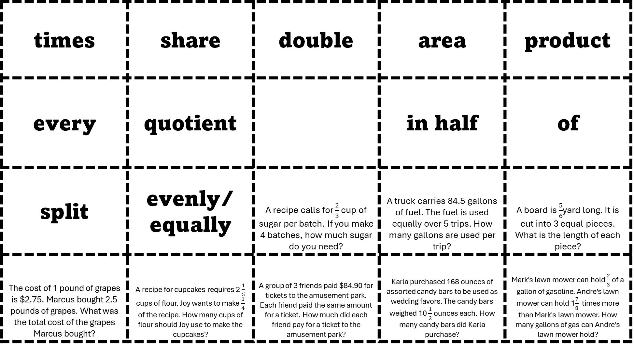
times | share | double | area | product
every | quotient | per | in half | of
split | evenly/ equally | A recipe calls for $\frac{2}{3}$ cup of sugar per batch. If you make 4 batches, how much sugar do you need? | A truck carries 84.5 gallons of fuel. The fuel is used equally over 5 trips. How many gallons are used per trip? | A board is $\frac{5}{6}$yard long. It is cut into 3 equal pieces. What is the length of each piece?
The cost of 1 pound of grapes is $2.75. Marcus bought 2.5 pounds of grapes. What was the total cost of the grapes Marcus bought? | A recipe for cupcakes requires 2 $\frac{1}{5}$ cups of flour. Joy wants to make $\frac{1}{4}$ of the recipe. How many cups of flour should Joy use to make the cupcakes? | A group of 3 friends paid $84.90 for tickets to the amusement park. Each friend paid the same amount for a ticket. How much did each friend pay for a ticket to the amusement park? | Karla purchased 168 ounces of assorted candy bars to be used as wedding favors. The candy bars weighed 10 $\frac{1}{2}$ ounces each. How many candy bars did Karla purchase? | Mark's lawn mower can hold $\frac{2}{3}$ of a gallon of gasoline. Andre's lawn mower can hold 1$\frac{7}{8}$ times more than Mark's lawn mower. How many gallons of gas can Andre's lawn mower hold?

